Slide 1

Sprint Week 1
Group #5

Slide 2

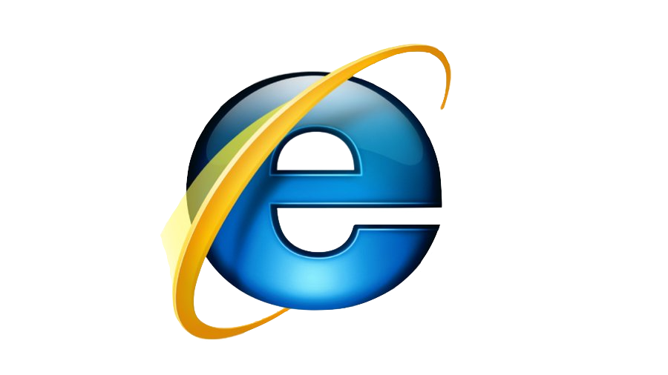
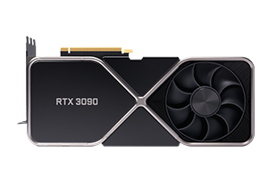
The end of an Era: Internet Explorer
The Stabilization of the GPU Market
Darla Ward
Jeffrey Coles-Clarke

Slide 3
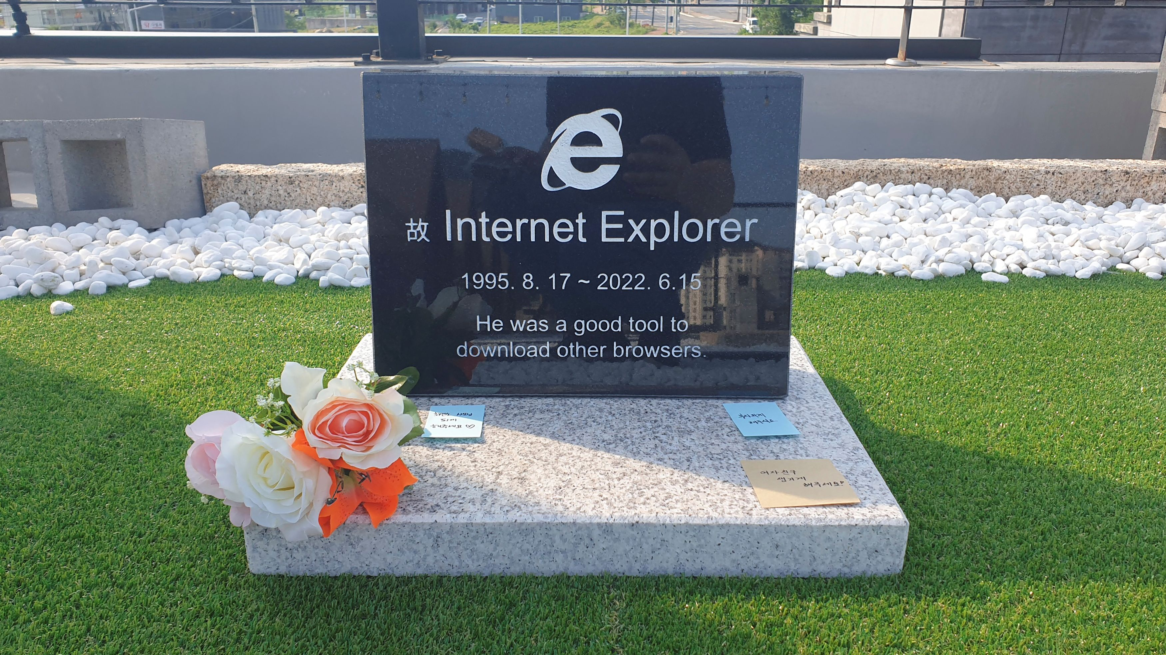
Microsoft ended its support for the Internet Explorer 11 browser on June 15th, 2022.

Slide 4
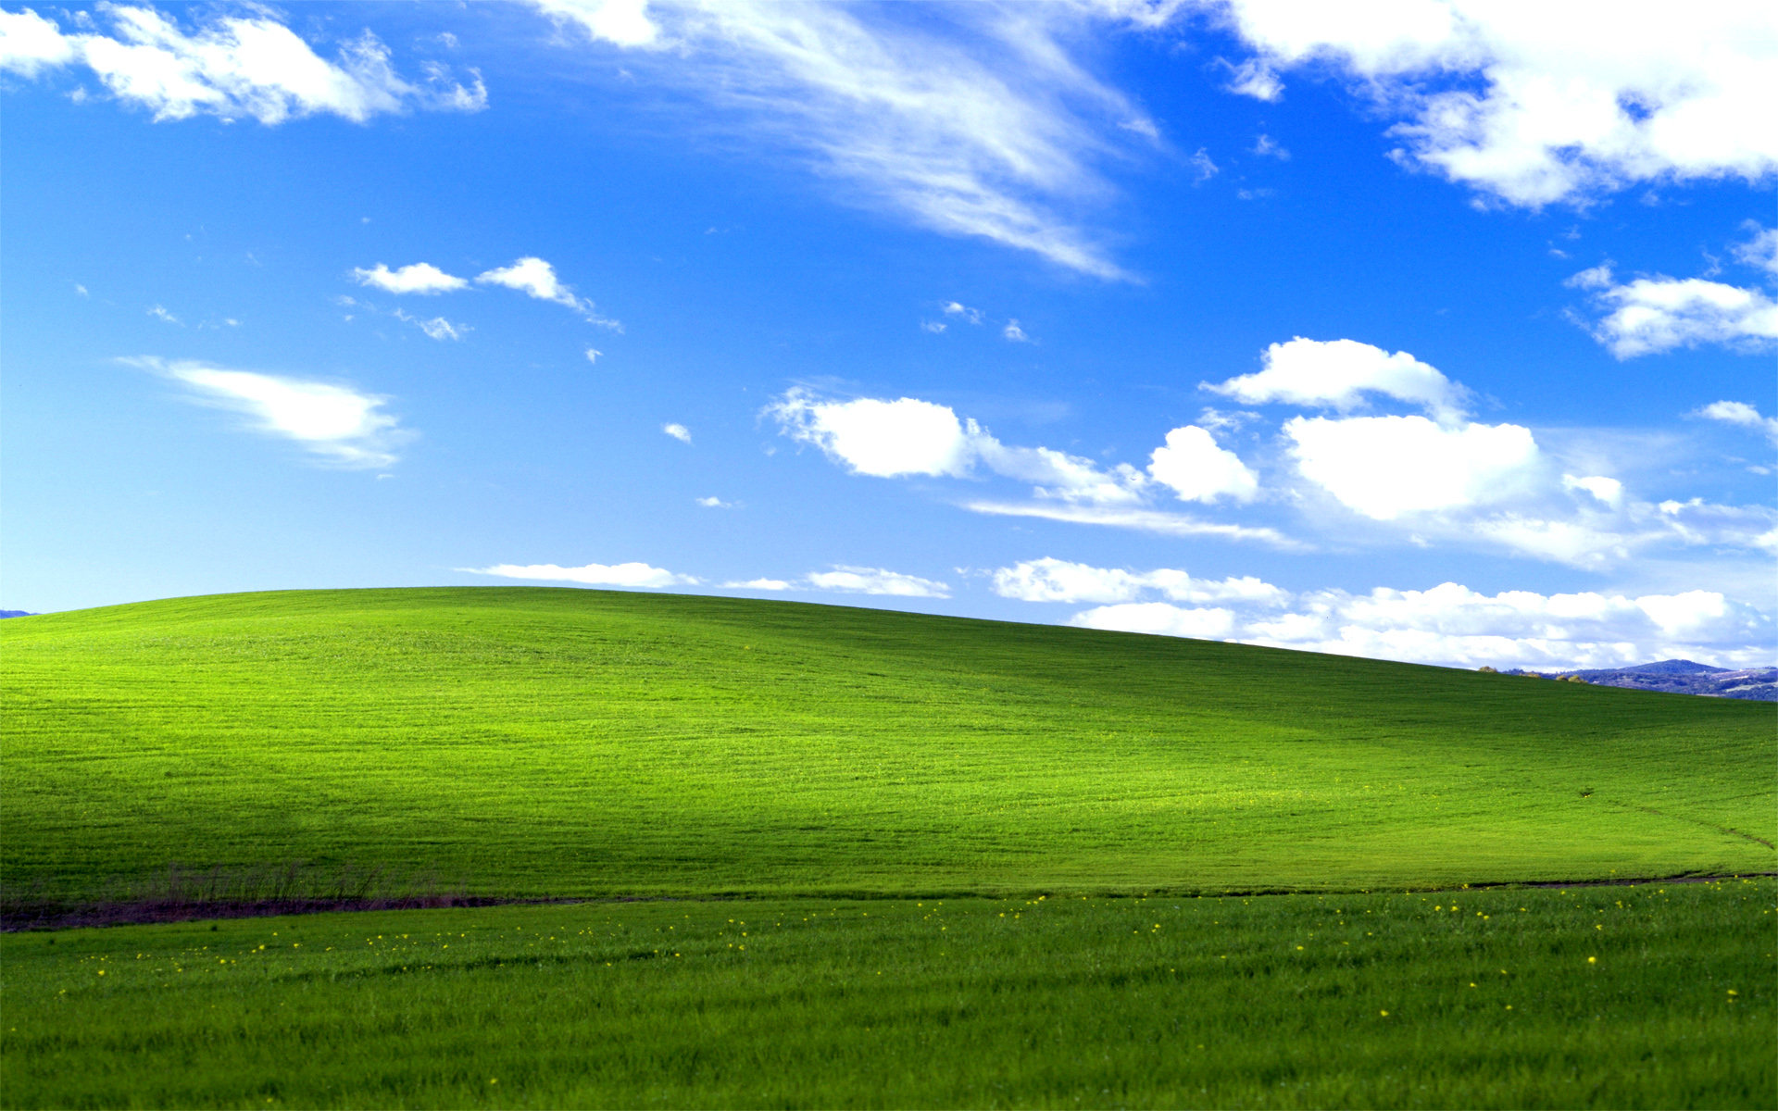
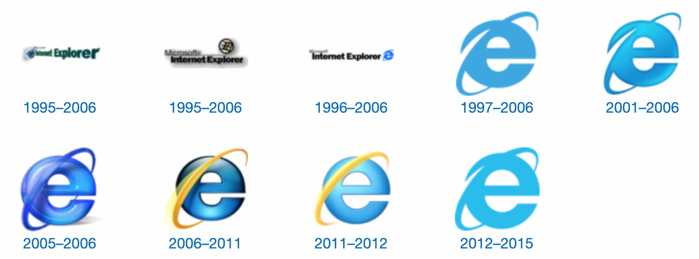
Internet Explorer And It’s Downfall
Internet explorer was first released on August 16th, 1995.
It was once the most widely used web browser but it’s user share had declined with the release of Firefox, Google Chrome and the rise in popularity of mobile operating systems, such as Android and iOS that did not support Internet Explorer.
To create better web compatibility for their customers and less fragmentation of the web for all web developers, Microsoft released Microsoft Edge on April 29th, 2015. This browser would include Internet Explorer mode(IE mode).
Evolution of the Internet Explorer Icon

Slide 5
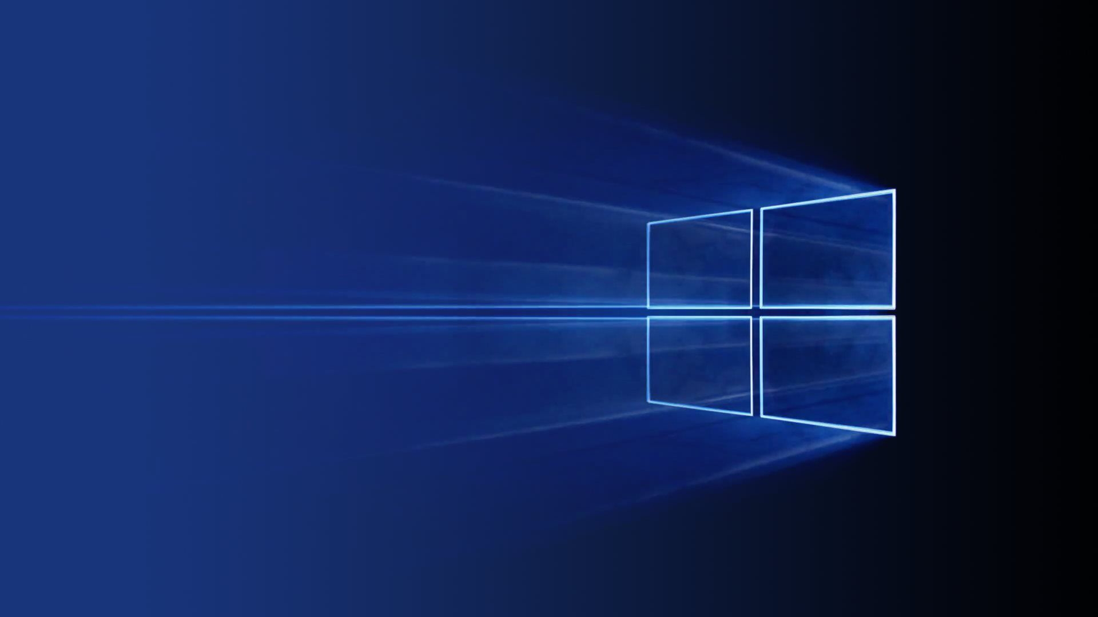
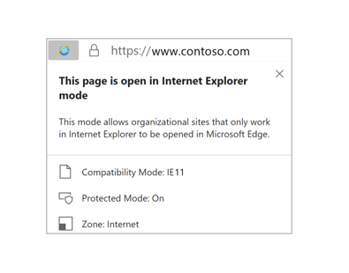
IE mode
To help companies and organizations that still need Internet Explorer 11 for backward compatibility, Microsoft created IE mode.
IE mode makes it easy to use legacy web/apps and modern web/apps in a single browser.
IE mode uses the integrated Chromium engine for modern sites, and the Trident MSHTML engine from Internet Explorer 11 for legacy sites.

Slide 6

The Normalisation of GPU prices in 2022

Slide 7

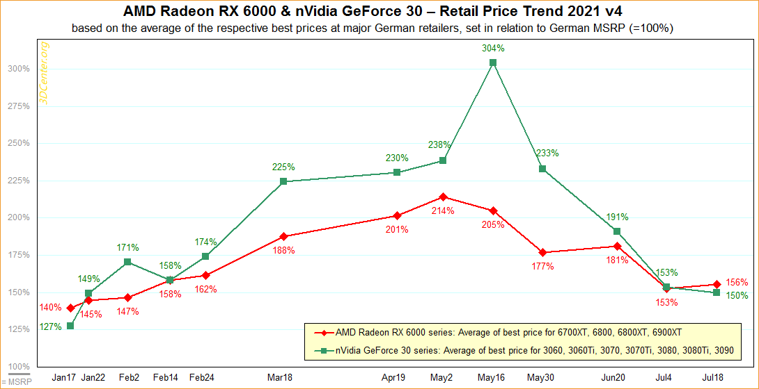
The Cause of the Price Increase
Covid-19 tore through the Eastern Nations, causing work shortages in the manufacturing industry.
Cryptocurrency was also a trend at the time, causing a large demand for tech products.
This created a perfect storm for an overall shortage in all tech products, but GPU’s were impacted more.
The shortage caused a drastic price increase in the price of GPU’s.
2021 GPU Price Graph

Slide 8

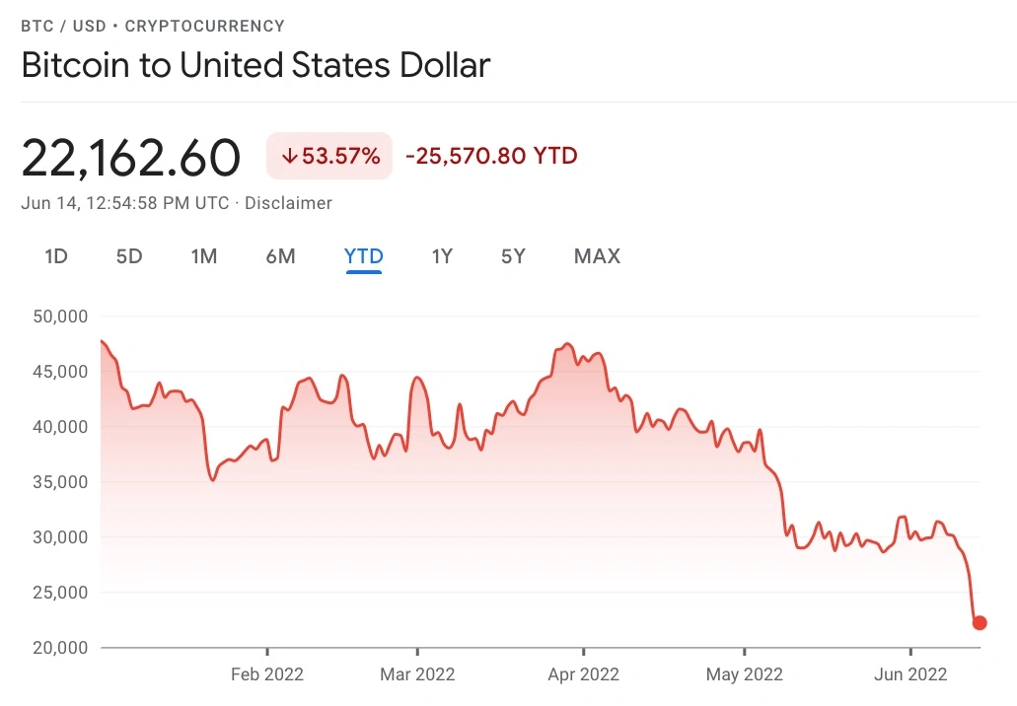
The Stabilisation of the GPU Market
The reduction in covid activity has caused people to start going back to work in person.
Along with that, the crypto market crashed recently, causing a decrease in interest in the industry.
This caused tech products to become more readily available, thus making the prices stabilise to their normal point.
Bitcoin Pricing Chart

